Slide 1
Accepting and Declining Invitations
Formal and Informal

Slide 2
Responding to Invitations
A formal reply is usually very short. It is brief and to the point. The quality of a good reply is that it must always be pleasant. Even while declining or expressing inability to attend one must be courteous. No need of unnecessary detail needed.
An informal reply or private letter may, however, express personal feelings or desires in an intimate style and informal tone.

Slide 3
Main Characteristics
Formal Replies
Acknowledge the invitation
Express thanks in third person
Mention acceptance/regret
Specify the reason for refusal
Be brief and specific
Be formal in tone and treatment
Do not exceed the word limit (50)

Slide 4
Formal Reply
Draft a formal reply accepting an invitation to be present on the occasion of the wedding of Samer S/O Mrs and Mr. Khan
Mrs and Mr Shafeeq thank Mrs and Mr Khan for inviting them on the wedding of their son on 15 May at their residence and assure them that they will be present on the occasion to wish the newly wed a very happy married life.
Mr. Shafeeq
5 may

Slide 5
You are Shezuka. You have been invited to participate in a seminar on ‘Fundamental rights of Children’ organized by the Literary Club of your district. Respond the invitation Acceptance and Denial
11, Doulat Road,
Lal Chowk
5 May 2010
The secretary
Literary Club, Srinagar
Sir,
Sub: Acceptance of Invitation
Thanks for your invitation for a seminar on ‘Fundamental rights of Children’, and your concern for the under-privileged children. I would like to utilize this opportunity to share my experience with other like- minded enthusiastics and experts.
I hereby confirm my participation in the seminar
Yours sincerely,
Shezuka

Slide 6
Inability to accept the invitation
Sir,
Sub: Inability to accept the invitation
Thank you very much for inviting me to participate in a seminar on ‘Fundamental rights of Children’. I feel honoured and obliged. However, I shall not be able to accept your invitation due to some previous commitments which keep me confined to my place on that day.
Thanking you once again for your kind invitation.
Yours sincerely,
Barq

Slide 7
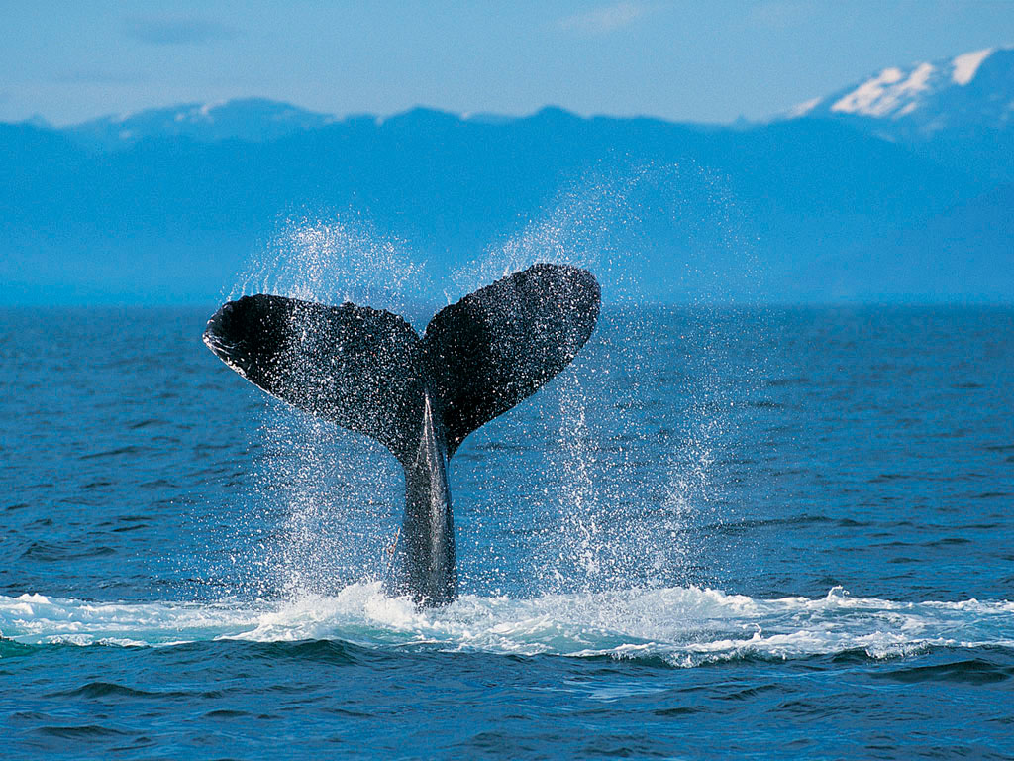
INFORMAL REPLIES

Slide 8
You are Yasir. You have been invited to attend the wedding of your friend’s sister during summer vacation. Respond to the invitation, regretting your inability to attend it.
New Delhi
4 March,2010
Dear Sameer,
Thank you for your cordial invitation on the occasion of your sister’s wedding. * I, however, regret my inability to be with you on this happy occasion as we shall be leaving for Shimla for summer holidays on 1 May 2010. please excuse my absence.
Yours sincerely.
* I would like to confirm my participation.
looking forward to the momentous occasion.
With love,
Sameer.

Slide 9
Mr. Ajay Mathur cordially invites you for Dinner at 6pm at
TAJ PALACE
SP MARG ON 30TH JULY 2011 to celebrate his promotion as General Manager

Slide 10
THANKS

